Slide 1
Power Automate in Microsoft Teams
Module 3
Notes:
Workshop Version: 1.4

Slide 2

Module overview
This module covers the following topics:
 | 1 | Overview of Power Automate in Microsoft Teams
 | 2 | Power Platform Connectors
 | 3 | Power Automate basics
 | 4 | Adaptive cards
 | 5 | Hands-on lab: Building flows with Power Automate

Slide 3





Overview of Power Automate in Microsoft Teams
Create and manage workflows through low-code/no-code experience
Improved integration and automation for Teams, channels, chats, and meetings
Speed up business processes and increase team productivity
Notes:
Users can create automated workflows between your apps and services to synchronize files, get notifications, collect data, and more using Power Automate.
Higher output and increased productivity have been two of the biggest reasons in justifying the use of automation.
Dataverse for Teams solution has improved integration and automation for Teams, channels, chats, and meetings to improve personal and team productivity

Slide 4
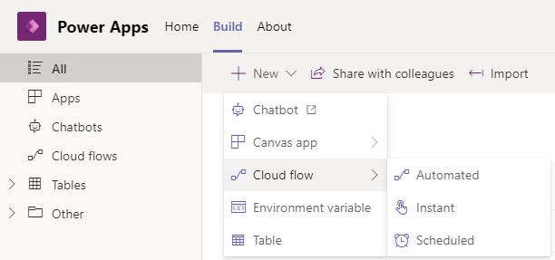
Flows in Dataverse for Teams
Flows can be built from within the Power Apps app in Microsoft Teams
Flows can be instant, scheduled, or automated
Notes:
Use the Power Apps app in Teams to create a cloud flow.
Prerequisites to flows using Power Apps in Teams:
1- The Power Apps app must be installed before you create flows in Teams
2- Before you can use the Power Apps app in Teams to create cloud flow, a Dataverse for Teams environment must already exist for that team.
3- A Dataverse for Teams environment is automatically provisioned when you create your first app in Teams
4- You cannot spin new Dataverse for Teams by creating Flow. It will always be triggered by Power App and PVA
You can create instant, scheduled, and automated flows, with access to over 450 connectors. This includes a connector to work with Microsoft Dataverse for Teams tables within Teams as well.

Slide 5




Power Automate basic concepts
Connectors
Triggers
Actions
Microsoft Confidential
Notes:
Each connector offers a set of operations classified as 'Actions' and 'Triggers’.

Slide 6

Power Platform Connectors
A connector is a proxy or a wrapper around an API that allows the underlying service to talk with Power Automate, Power Apps, or Azure Logic Apps
Connectors enable you to connect apps, data, and devices in the cloud
Notes:
Our large ecosystem of software as a service (SaaS) connectors enable you to connect apps, data, and devices in the cloud.
Each connector offers a set of operations classified as 'Actions' and 'Triggers'. Once you connect to the underlying service, these operations can be easily leveraged within your apps and workflows.
For the full list of connectors, please refer to https://docs.microsoft.com/en-us/connectors/connector-reference/connector-reference-powerautomate-connectors.
List of all connectors published by Microsoft | Microsoft Docs
List of all Standard tier connectors | Microsoft Docs

Slide 7







Standard and premium connectors
Standard connectors are connectors that are available for use with every level of licensing within Dataverse for Teams
Examples of standard connectors:
​
SharePoint
Office 365
Users
Adobe Sign
Dataverse (Dataverse for
Teams only)
Premium connectors require additional licensing
Examples of premium connectors:
​
HTTP
SQL Server
SalesForce
Dataverse
(any Dataverse)
Notes:
Standard connectors are connectors that are freely available for use with every level of licensing within PowerApps
Connector reference: Connector reference overview | Microsoft Docs
Tier: Standard and Premium .
Dataverse connector is a Premium connector, but within Dataverse for Teams environment the same connector becomes Standard

Slide 8


How do Power Platform connectors work?
Connector ID
+
Operation
+
Connection ID
Host
+
Path
+
Credentials
Triggers
Actions
Operations
Power Automate
Custom web API
Connectors
Power Apps
RESTful API
Connection ID
Credentials
Token store (Connections)
Azure resources
Logic Apps
Microsoft Confidential
Notes:
https://docs.microsoft.com/en-us/connectors/connectors
These need-to-know terminologies:
Power Automate - Power Automate is a cloud-based service that makes it practical and simple for educators to build flows that automate time-consuming tasks and processes across applications and services.
Templates - Templates are pre-built flows for popular and common scenarios. Using a template only requires educators to have access to the services in the template and to fill out any required settings.
Connectors - Connectors provide ways to connect services or applications to build flows. Examples of popular connectors include Outlook, OneDrive for Business, and SharePoint.
Connections - Connections make it easy for users to connect to their services or applications using their active Microsoft credentials or login. Once logged into the services or applications, automations can happen between the different connectors to build flows.
Triggers – A trigger is the first step in the flow, it decides how the flow starts.
Actions – Actions are any item that takes place after the trigger.

Slide 9
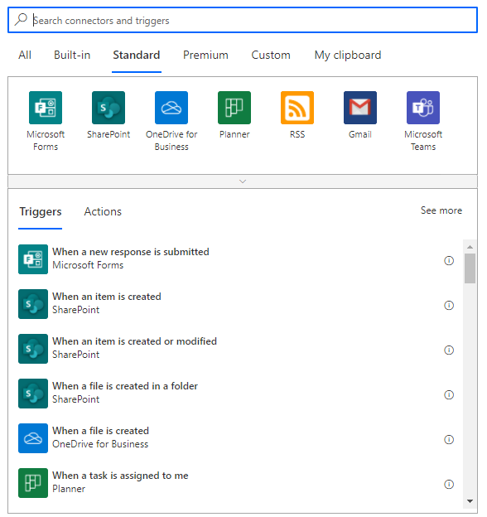
Triggers
Triggers prompt a flow to begin when a specific event occurs
Most connectors offer pre-built triggers to start your flows
The trigger must be the first step of the flow
Each flow can only have one trigger
Notes:
Discuss , automate task so you don’t have to repeat yourself such as save all your emails attachments to a folder automatically.
A trigger is the event that starts a cloud flow. For example, if you want to get notification in Microsoft Teams when someone sends you an email, in this case you receiving an email is the trigger that starts this flow.
Power Automate offers connectors (apps/services like SharePoint, Outlook, and others ) and most connectors offer prebuilt triggers that you can use to start your flows.
You might want to discuss that webhooks triggers are not available with Dataverse for Teams
https://docs.microsoft.com/en-us/connectors/connectors

Slide 10
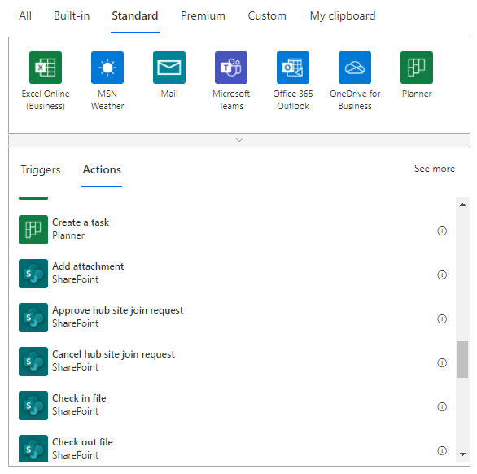
Actions
Actions are steps of the flow
Available actions are defined in connector
Notes:
https://docs.microsoft.com/en-us/connectors/connectors

Slide 11
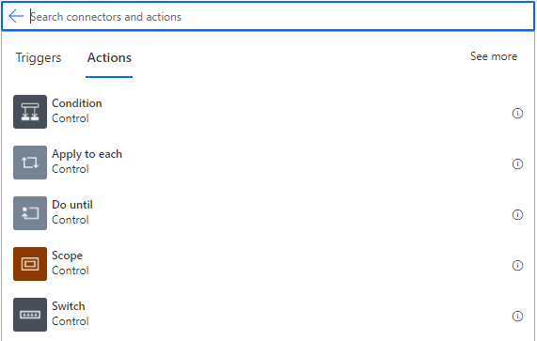
Flow Control Actions
Use Conditions to perform one or more actions only under certain circumstances
Use Apply to each action to process a list of items
Use Do until for looping
Use a Scope to group two or more actions together
Use Switch to have parallel branches of conditional logic based on a single value
Notes:
You can find examples of all these Actions explanation in this module Appendix
Documentation :
https://flow.microsoft.com/en-us/blog/build-advanced-flows/
Flow / search-by-service https://flow.microsoft.com/en-us/blog/build-advanced-flows/ and https://flow.microsoft.com/en-us/blog/search-by-service/
Build Advanced Flow https://flow.microsoft.com/en-us/blog/build-advanced-flows/

Slide 12
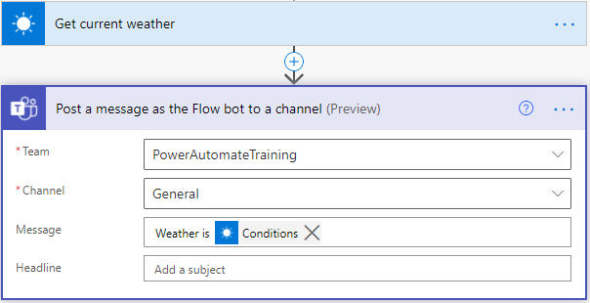
Dynamic content and expressions
Dynamic content – reuse any values that exist in the context of the current flow
Expressions – perform various transformations and calculations

Slide 13
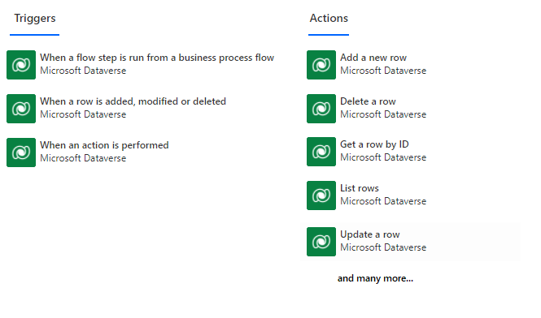
Microsoft Dataverse connector
Trigger on table changes
Create, read, update, delete rows in your tables
Build complex queries to your custom data model
Treated as Standard connector only in Dataverse for Teams

Slide 14
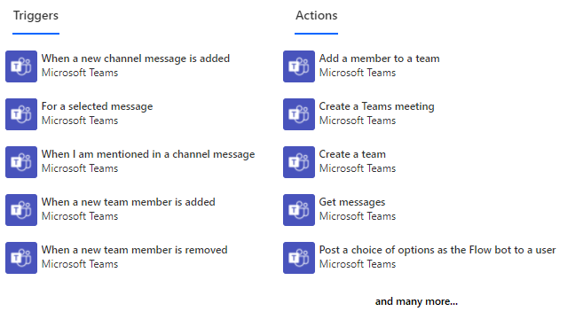
Microsoft Teams Connector
Integrate anything with Microsoft Teams using built-in Microsoft Teams connector
Has numerous triggers and actions

Slide 15
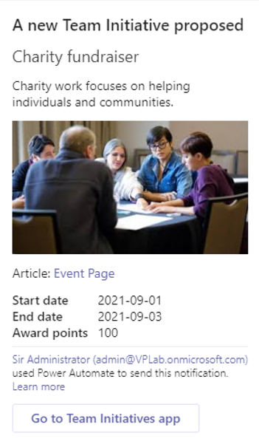
Adaptive Cards
Adaptive Cards are a platform-agnostic method of sharing and displaying blocks of information
Consistent UI patterns to display information as part of a business process/automation
Author Adaptive Cards in JSON format
Notes:
Adaptive cards https://docs.microsoft.com/en-us/power-automate/overview-adaptive-cards
1- Adaptive Cards are a platform-agnostic method of sharing and displaying blocks of information without the complexity of customizing CSS or HTML to render them
2- You author Adaptive Cards in JSON format, with integrations that cloud apps and services can openly exchange.
3- When delivered to a specific host, such as Microsoft Teams, the JSON is transformed into native User Interface ( UI) that automatically adapts to its host. Therefore, process designers can now offer consistent UI patterns whenever they need to display information as part of a business process/automation.
4- Since Adaptive Cards adapt to their host, they are perfect vehicles for sharing information between Microsoft Teams and other services.
CSS is a style sheet language that gives appearance changes to a markup language. For example, HTML is used to create the basic layout of a web page such as this paragraph of text.
CSS describes how HTML elements are to be displayed on screen, paper, or in other media.

Slide 16
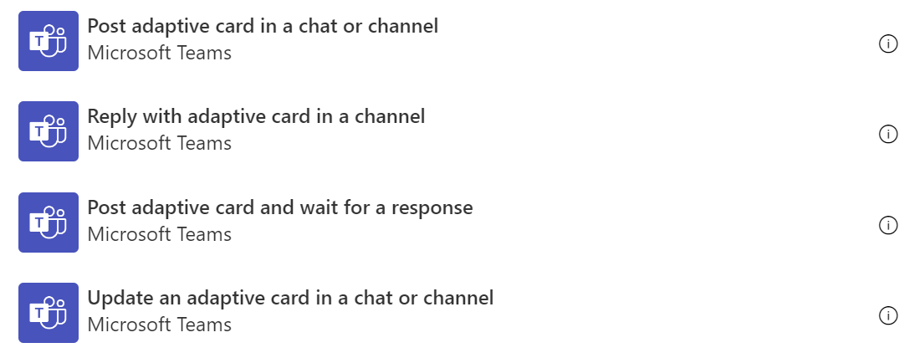
Actions with Adaptive Cards
Available in Microsoft Teams and Office 365 Outlook connectors
Send cards directly to users
Send cards to team channels
Notes:
Adaptive cards: https://docs.microsoft.com/en-us/power-automate/overview-adaptive-cards
Directing content to Teams members or AAD users
Post your own adaptive card as the Flow bot to a user
Post an adaptive card as the Flow bot to a Teams user, and wait for a response
Directing content to Teams channels
Post your own adaptive card as the Flow bot to a channel
Post an adaptive card as the Flow bot to a Teams channel, and wait for a response

Slide 17
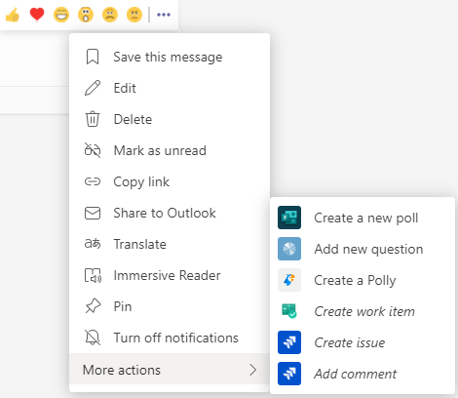
Trigger Flow from Teams messages
Start a flow from any message in Teams, using For a selected message trigger
Create custom forms to collect information from Teams
Use the message details within the flow for more context
Microsoft Confidential

Slide 18

Lab 3: Building flows with Power Automate
Objectives
Create an announcement flow
Create a flow to handle approvals
Never upload your organization data to the lab tenant.
Notes:
Refer to lab 2-0 instructions
##########

Slide 19
Appendix

Slide 20
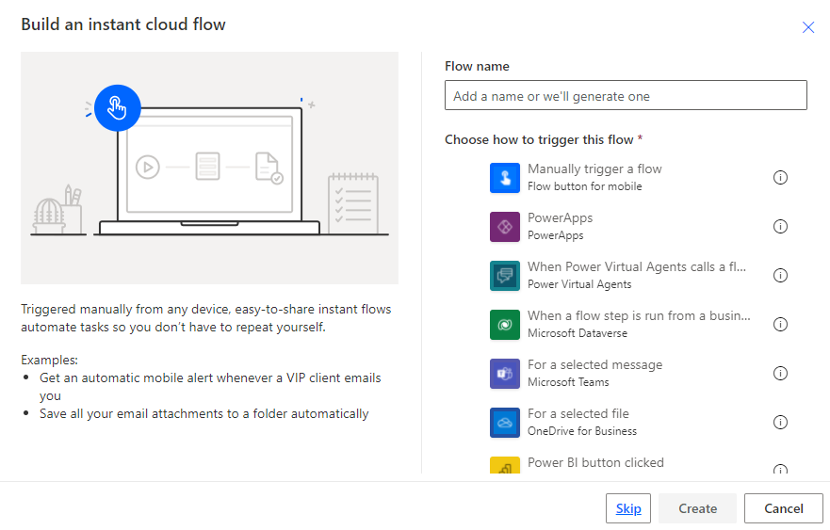
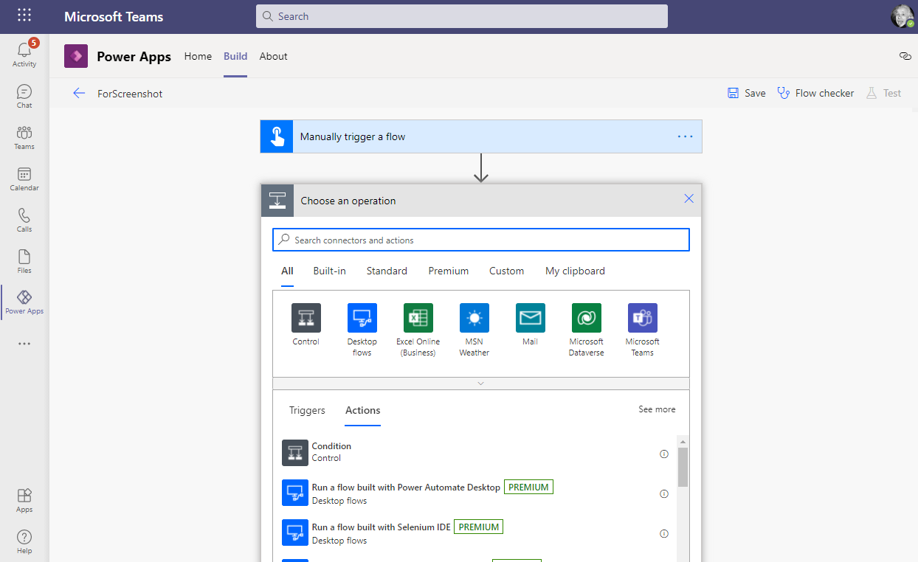
Create Cloud flows in Power Apps app
Select flow type
Select preferred trigger
Add actions
Microsoft Confidential

Slide 21
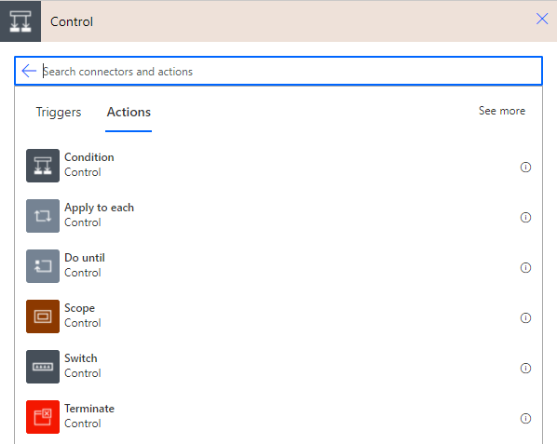
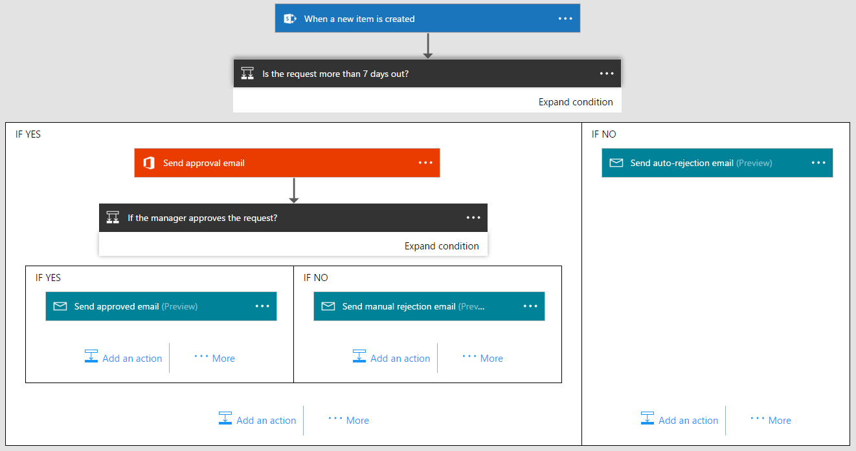
Use Conditions for simple branching
Microsoft Confidential
Notes:
You can specify that a flow performs one or more tasks only if the condition is met.

Slide 22
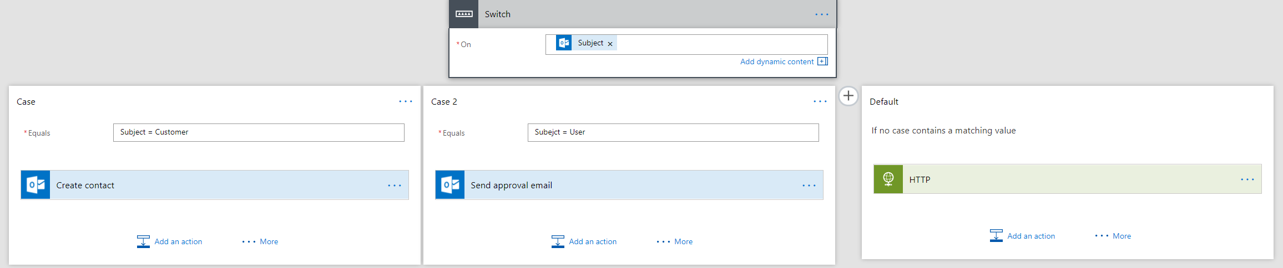
Use Switch Case for advanced branching
Microsoft Confidential
Notes:
Switch blocks allow you to have multiple conditions
Documentation :
https://flow.microsoft.com/en-us/blog/build-advanced-flows/

Slide 23
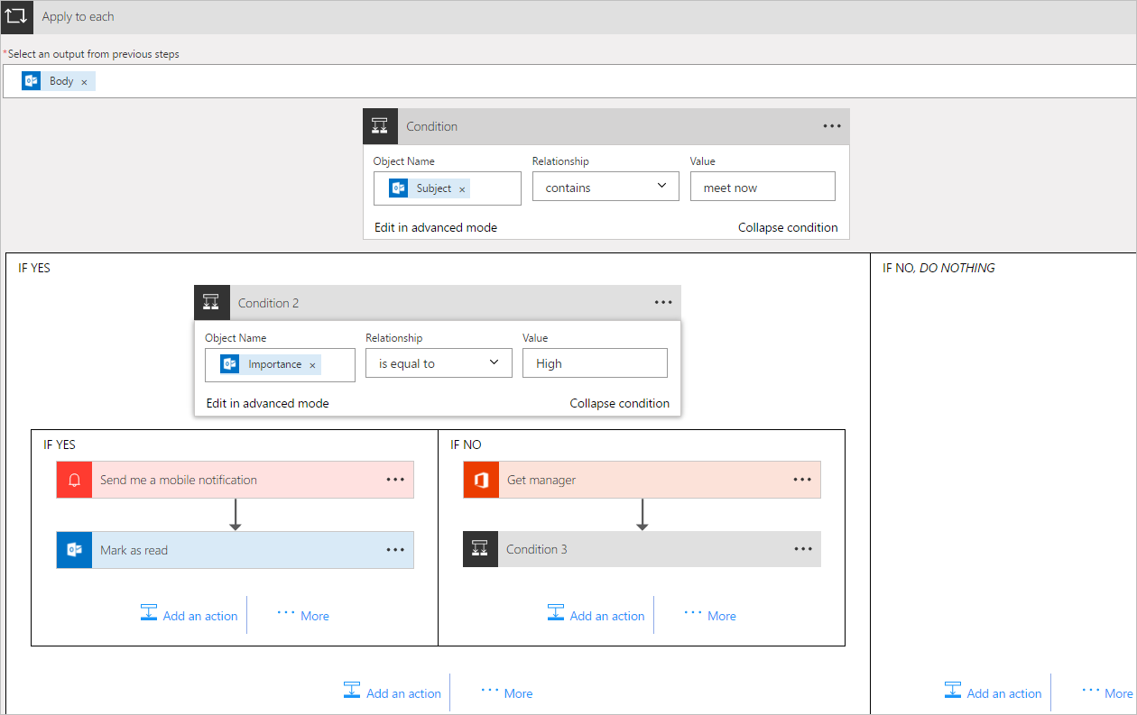
Use Apply to each action to process a list of items
Microsoft Confidential
Notes:
When you use the apply to each control, you will have to choose an output from the previous step, for which the future actions will apply to.
Documentation :
https://docs.microsoft.com/en-us/flow/apply-to-each

Slide 24
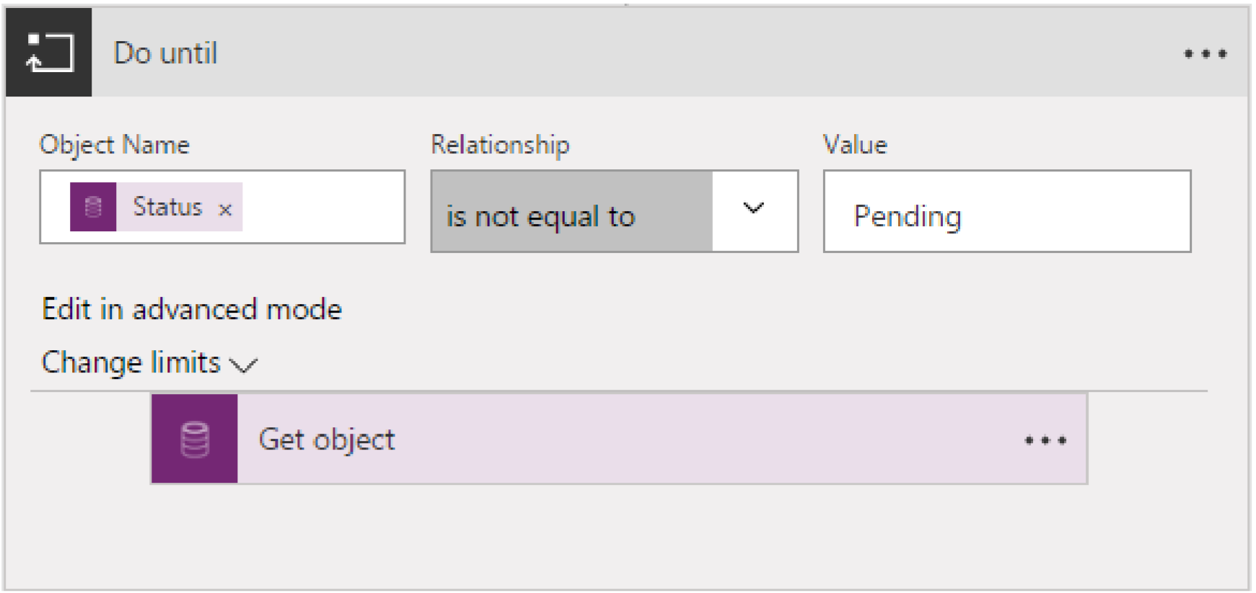
Use Do until for looping
Microsoft Confidential
Notes:
Do until makes the flow repeat a step until a certain condition is met. This is often used in approval scenarios.

Slide 25
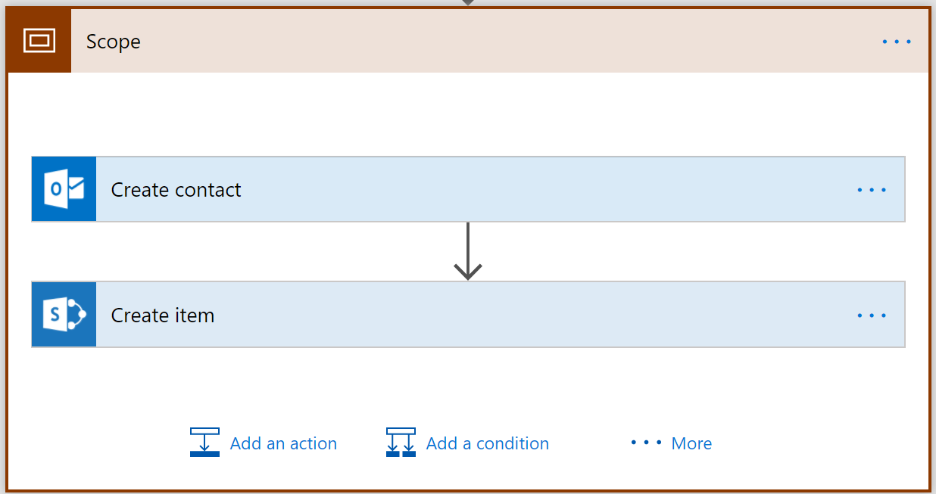
Use a Scope to group two or more actions together
Microsoft Confidential
Notes:
Scopes allow you to visually collapse the actions inside of them. Think of scopes as an organizational control.
Remember you can change the name of the scope.

Slide 26
Questions?

